Slide 1
Living History
A Mobile App to explore preserved historic buildings and locations in the city of Zurich

Slide 2
Updates
Gartendenkmalinventar
Filtering by Typ (e.g. Vorgarten, Schulhausanlage, …)
Denkmalschutzobjekt
Filtering by year → problem with the fieldtype
Brunnen wont be used at all (no categories, descriptions or anything else)
Basemap from OpenDataZurich (Übersichtsplan)
Addition:
Historical basemaps as an overlay over the recent basemap
No historic map during routing!

Slide 3
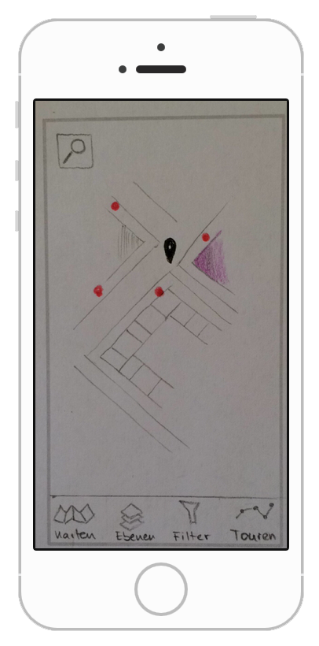
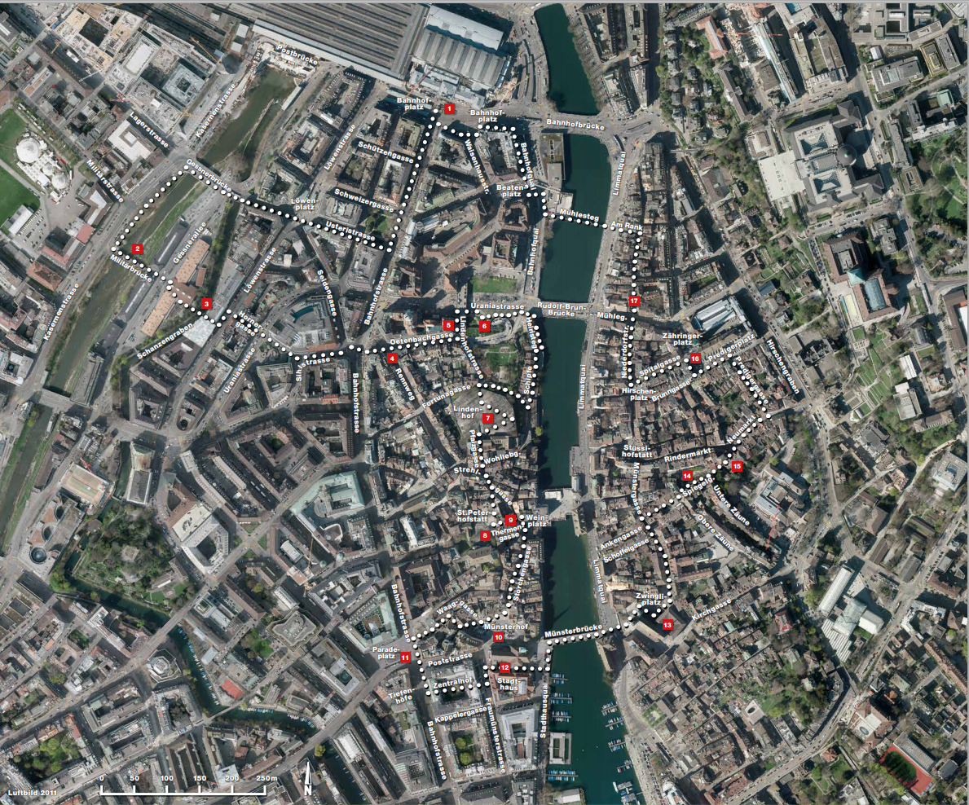
Project Status
Notes:
https://www.stadt-zuerich.ch/ted/de/index/stadtverkehr2025/zu-fuss/routen/innenstadt.html
https://popapp.in/w/projects/5613d8092612311f148c1fdf/preview

Slide 4
Vision and Goals
Let users experience historic preserved Zurich
Highlight preserved, historic objects
Locate and guide the user through history
Provide thematic tours to explore
Make it user-friendly

Slide 5
Functional Requirements
The map must provide zooming, panning and layer selection
A search-function needs to be implemented
Search by name with autofill
Filters need to be available to only show data of interest
Geometric search with a buffer
Thematic search by time period
Current Location needs to be shown on the map all the time
List of tours provides the option to choose one and then find the way to the starting-point
Historic maps can be selected as basemap

Slide 6
Tasks
Design Tours
Prepare Start Screen
OGD Data Processing
Design of the GUI
App Design
App Functionalities
Location
Search
Pop-up
Routing
Filtering
Tours
App Testing
Intermediate Presentation
Report
Final Presentation

Slide 7
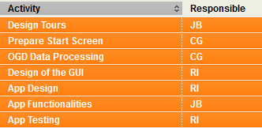
Responsibilities
JB = Julia Burgermeister
CG = Charalampos Gkonos
RI = Rebecca Ilehag

Slide 8
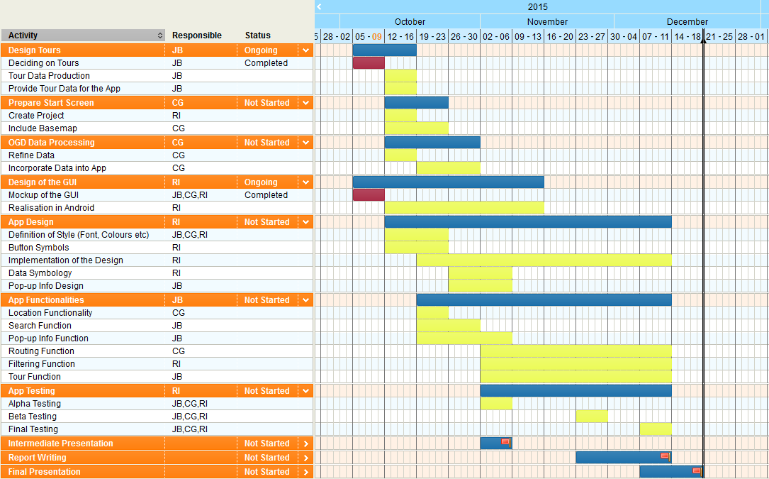
Schedule
Notes:
https://www.tomsplanner.com/?template=new#doc=AzLhKgZYPWlONJFgLPOz

